Slide 1
Chapter 2: Fundamentals of Logic
謝孫源 講座教授
hsiehsy@mail.ntcku.edu.tw
國立成功大學 資訊工程系

Slide 2
Outline
Basic Connectives and Truth Tables
Logical Equivalence: The Laws of Logic
Logical Implication: Rules of Inference
The Use of Quantifiers
Quantifiers, Definitions, and the Proofs of Theorems

Slide 3
Statements (1/5)
Statements (or propositions): declarative sentences that are either true or false but not both.
Examples:
  p: Combinatorics is a required course for sophomores.
  q: Margaret Mitchell wrote Gone with the Wind.
  r: 2 + 3 = 5.
Non-statements: (do not have truth values)
  “What a beautiful evening!” (exclamation)
  “Get up and do your exercises.” (command)
Notes:
Statement: 陳述,說明
Proposition: 陳述;主張;論點
Declarative: 宣言的;佈告的;申報的;陳述的
Combinatorics: (用作單數)組合數學
Sophomore: (大學,高中的)二年級學生

Slide 4
Statements (2/5)
Primitive statements: there is really no way to break them down into anything simpler.
New statements can be obtained from existing ones in two ways.
Negation: We do not consider the negation of a primitive statement to be a primitive statement.
¬ p : Combinatorics is not a required course for sophomores.
Notes:
Primitive: 簡單的, 基本的

Slide 5

Statements (3/5)
Compound statement, using the following logical connectives:
  Conjunction ∧
  p ∧ q: “Combinatorics is a required course for sophomores, and Margaret Mitchell wrote Gone with the Wind.”
  Disjunction ∨
  p ∨ q (inclusive): true if one or the other of p, q is true or if both of the statements p, q are true.
  (exclusive): true if one or the other of p, q is true but not both of the statements p, q are true.

Slide 6
Statements (4/5)
  Implication →
  p → q: “If combinatorics is a required course for sophomores, then Margaret Mitchell wrote Gone with the Wind.”
  Alternatively, we can say
    “If p, then q.”
    “p is sufficient for q.”
    “p is a sufficient condition for q.”
    “q is necessary for p.”
    “q is a necessary condition for p.”
    “q only if p.”

Slide 7
Statements (5/5)
    The statement p is called the hypothesis of the implication; q is called the conclusion.
  Biconditional ↔
  p ↔ q: “Combinatorics is a required course for sophomores, if and only if Margaret Mitchell wrote Gone with the Wind.”
    “p if and only if q” or “p is necessary and sufficient for q.”
    Abbreviate “p if and only if q” as “p iff q.”
Note: A sentence such as “The number x is an integer.” is not a statement because its truth value cannot be determined until a numerical value is assigned for x.
Notes:
Hypothesis: 假說;前提

Slide 8
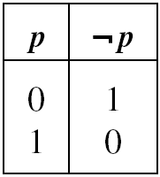
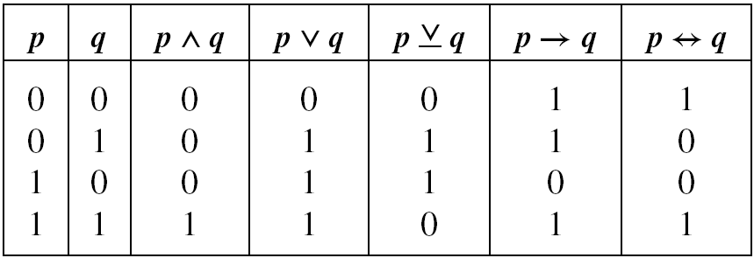
Truth Table
“0” for false and “1” for true

Slide 9
Example of implication (1/2)
Example 2.2: It is almost the week before Christmas and Penny will be attending several parties that week. Ever conscious of her weight, she plans not to weigh herself until the day after Christmas. Considering what those parties may do to her waistline by then, she makes the following resolution for the December 26 outcome: “If I weigh more than 120 pounds, then I shall enroll in an exercise class.”
Notes:
Waistline: 腰圍
Resolution: 決心;決定
Enroll:入會,參加

Slide 10
Example of implication (2/2)
Example 2.2 (cont.):
Let p and q denote the (primitive) statements
p: I weigh more than 120 pounds.
q: I shall enroll in an exercise class.
Then Penny’s statement (implication) is given by p → q.
We shall consider the truth values of this particular example of p → q

Slide 11
Example of Compound Statement (1/2)
Example 2.4: Let us examine the truth table for the compound statement “Margaret Mitchell wrote Gone with the Wind, and if 2 + 3 ≠ 5, then combinatorics is a required course for sophomores.”
  p: Combinatorics is a required course for sophomores.
  q: Margaret Mitchell wrote “Gone with the Wind”.
  r: 2 + 3 = 5.
q ∧ (¬r → p)

Slide 12
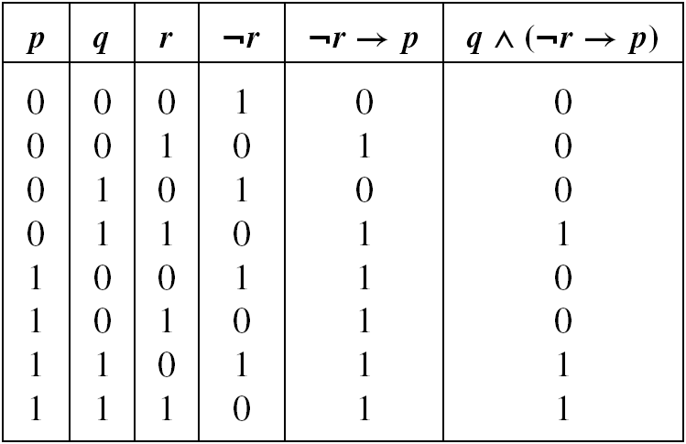
Example of Compound Statement (2/2)
Example 2.4 (cont.):

Slide 13
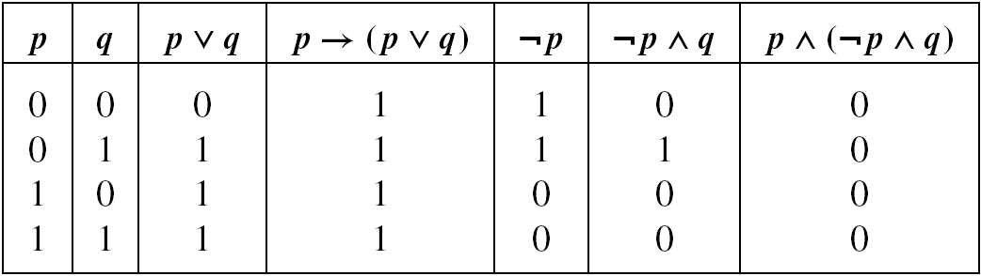
Tautology and Contradiction
Definition 2.1: A compound statement is called a tautology if it is true for all truth value assignments for its component statement. If a compound statement is false for all such assignments, then it is called a contradiction.
EXERCISES 2.1: 4, 6
Use the symbol T₀ to denote any tautology.
Use the symbol F₀ to denote any contradiction.
Notes:
Tautology:同義反複;重複,贅述
Contradiction:矛盾

Slide 14
Outline
Basic Connectives and Truth Tables
Logical Equivalence: The Laws of Logic
Logical Implication: Rules of Inference
The Use of Quantifiers
Quantifiers, Definitions, and the Proofs of Theorems

Slide 15
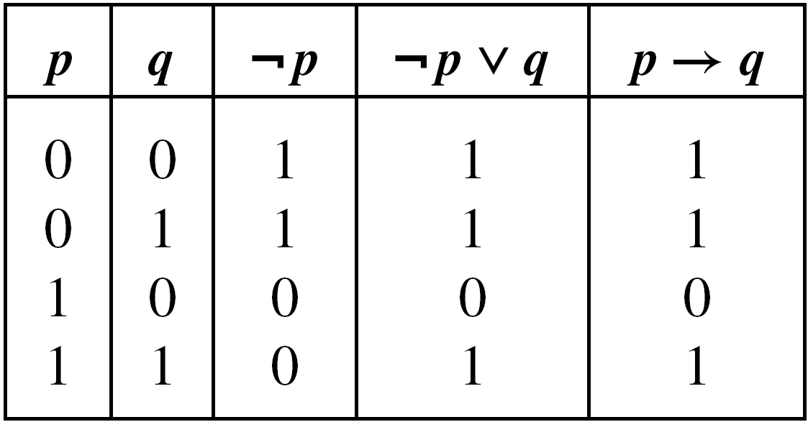
Logical Equivalence
Definition 2.2: Two statements s₁, s₂ are said to be logically equivalent, and we write s₁ ⇔ s₂, when the statement s₁ is true (respectively, false) if and only if the statement s₂ is true (respectively, false).
We can eliminate the connective → from compound statements.
∴ ¬p ∨ q ⇔ p → q

Slide 16
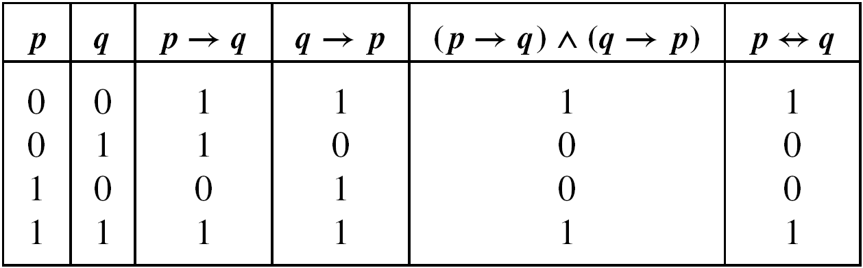
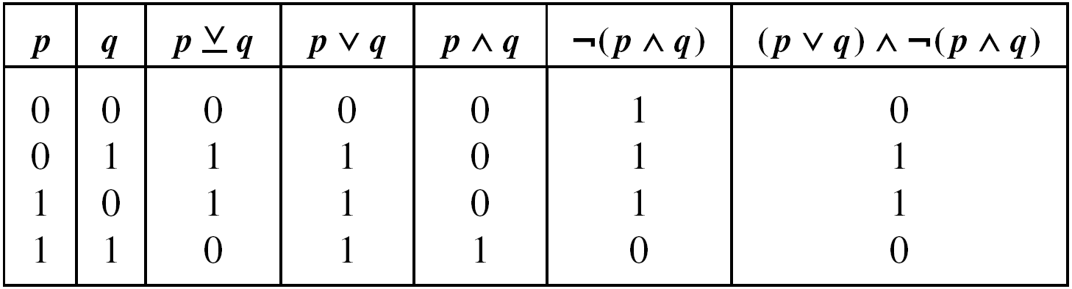
Eliminate Connectives from Compound Statements
(p ↔ q) ⇔ (¬p ∨ q) ∧ (¬q ∨ p)

Slide 17
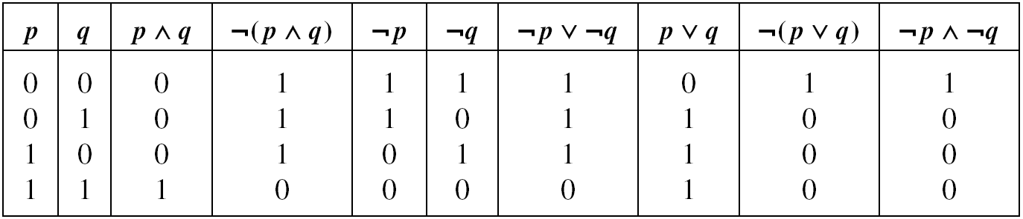
Important Properties (1/2)
Example 2.8: (DeMorgan’s Laws)
¬(p ∧ q) ⇔ ¬p ∨ ¬q
¬(p ∨ q) ⇔ ¬p ∧ ¬q

Slide 18
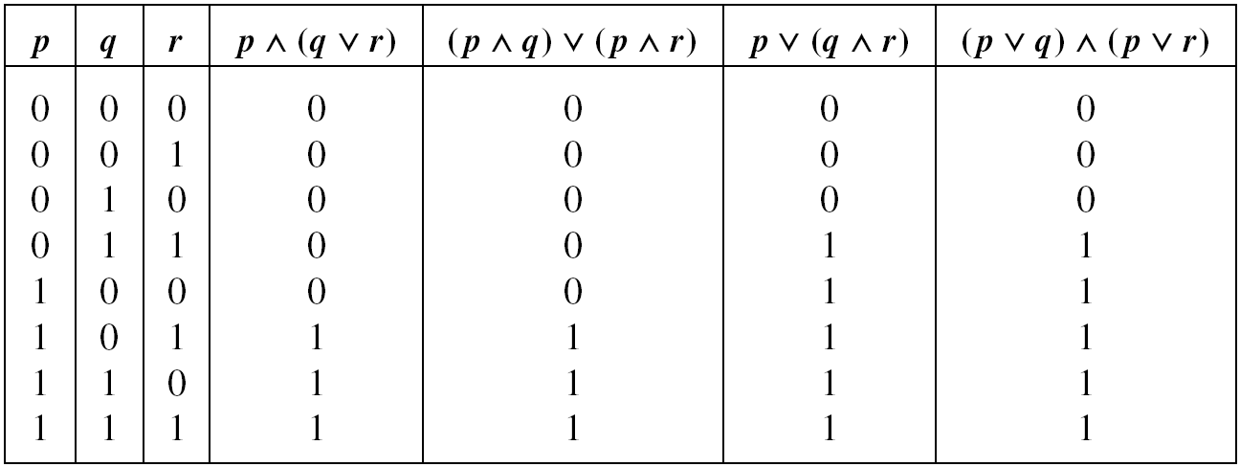
Important Properties (2/2)
Example 2.9: (Distributive Law)

Slide 19
The Laws of Logic (1/2)
For any primitive statements p, q, r, any tautology T₀, and any contradiction F₀,
1) ¬¬p ⇔ p Law of Double Negation
2) ¬(p ∨ q) ⇔ ¬p ∧ ¬q DeMorgan’s Laws
¬(p ∧ q) ⇔ ¬p ∨ ¬q
3) p ∨ q ⇔ q ∨ p Commutative Laws
p ∧ q ⇔ q ∧ p
4) p ∨ (q ∨ r) ⇔ (p ∨ q) ∨ r Associative Laws
p ∧ (q ∧ r) ⇔ (p ∧ q) ∧ r

Slide 20
The Laws of Logic (2/2)
5) p ∨ (q ∧ r) ⇔ (p ∨ q) ∧ (p ∨ r) Distributive Laws
p ∧ (q ∨ r) ⇔ (p ∧ q) ∨ (p ∧ r)
6) p ∨ p ⇔ p Idempotent Laws
p ∧ p ⇔ p
7) p ∨ F₀ ⇔ p Identity Laws
p ∧ T₀ ⇔ p
8) p ∨ ¬p ⇔ T₀ Inverse Laws
p ∧ ¬p ⇔ F₀
9) p ∨ T₀ ⇔ T₀ Domination Laws
p ∧ F₀ ⇔ F₀
10) p ∨ (p ∧ q) ⇔ p Absorption Laws
p ∧ (p ∨ q) ⇔ p

Slide 21
Dual of Statement (1/3)
Definition 2.3: Let s be a statement. If s contains no logical connectives other than ∧ and ∨, then the dual of s, denoted s^{d}, is the statement obtained from s by replacing each occurrence of ∧ and ∨ by ∨ and ∧, respectively, and each occurrence of T₀ and F₀ by F₀ and T₀, respectively.

Slide 22
Dual of Statement (2/3)
If p is any primitive statement, then
  p^{d} is the same as p
  (¬p)^{d} is the same as ¬p
  p ∨ ¬p and p ∧ ¬p are duals of each other
  p ∨ T₀ and p ∧ F₀ are duals of each other

Slide 23
Dual of Statement (3/3)
Theorem 2.1 (The Principle of Duality): Let s and t be statements that contain no logical connectives other than ∧ and ∨. If s ⇔ t, then
s^{d} ⇔ t^{d}.
Laws 2 through 10 in our list can be established by proving one of the laws in each pair and then invoking this principle.

Slide 24
Substitution Rules
Suppose that the compound statement P is a tautology. If p is a primitive statement that appears in P and we replace each occurrence of p by the same statement q, then the resulting compound statement P₁ is also a tautology.
Let P be a compound statement where p is an arbitrary statement that appears in P, and let q be a statement such that q ⇔ p. Suppose that in P we replace one or more occurrences of p by q. Then this replacement yields the compound statement P₁. Under these circumstances P₁ ⇔ P.
Notes:
P 是 tautology, 每個 p 都用 q 代替, P1 還是 tautology.
p 和 q logically equivalent, 部分 p 用 q 代替, P 和 P1 logically equivalent.

Slide 25
Examples of Substitution Rules (1/3)
Example 2.10: (Substitution Rule 1)
  (From DeMorgan’s Laws) P: ¬(p ∨ q) ↔ (¬p ∧ ¬q) is a tautology.
  P₁: ¬[(r ∧ s) ∨ q] ↔ [¬(r ∧ s) ∧ ¬q] is a tautology.
  P₂: ¬[(r ∧ s) ∨ (t → u)] ↔ [¬(r ∧ s) ∧ ¬ (t → u)] is also a tautology.

Slide 26
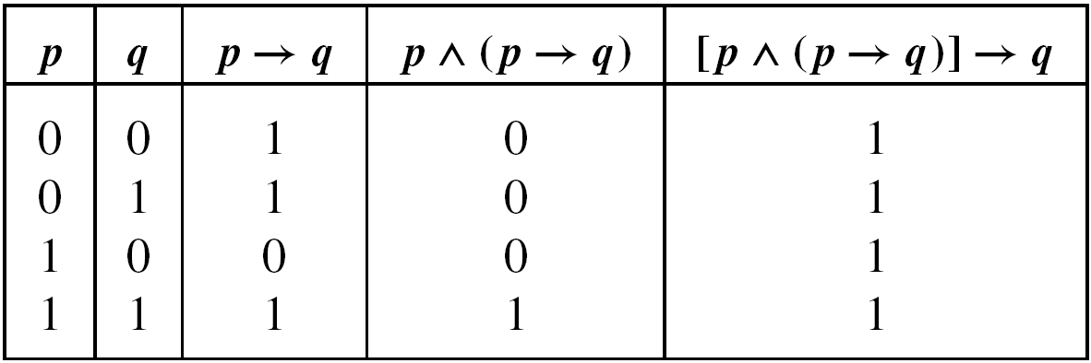
Examples of Substitution Rules (2/3)
Example 2.10 (cont.): (Substitution Rule 1)
[p ∧ (p → q)] → q is a tautology.
(r → s) ∧ [(r → s) → (¬t ∨ u)] → (¬t ∨ u) is also a tautology.

Slide 27
Examples of Substitution Rules (3/3)
Example 2.11: (Substitution Rule 2)
P: p → (p ∨ q) is a tautology.
P₁: p → (¬¬p ∨ q) is also a tautology.
(Since ¬¬p ⇔ p.)

Slide 28
Examples (1/6)
Example 2.12: Negate and simplify the compound statement (p ∨ q) → r.
  (p ∨ q) → r ⇔ ¬(p ∨ q) ∨ r
  ¬[(p ∨ q) → r] ⇔ ¬[¬(p ∨ q) ∨ r]
  ¬[¬(p ∨ q) ∨ r] ⇔ ¬¬(p ∨ q) ∧ ¬r
  ¬¬(p ∨ q) ∧ ¬r ⇔ (p ∨ q) ∧ ¬r
¬[(p ∨ q) → r] ⇔ (p ∨ q) ∧ ¬r

Slide 29
Examples (2/6)
Example 2.13: Let p, q denote the primitive statements
p: Joan goes to Lake George.
q: Mary pays for Joan’s shopping spree.
and consider the implication
p → q: If Joan goes to Lake George, then Mary pays for Joan’s shopping spree.
How to write the negation of p → q in a way other than simply ¬(p → q)?
Notes:
Lake George (喬治湖): 紐約州的度假勝地 (http://blog.roodo.com/meaningful/archives/2078539.html)
Pay for: 受到懲罰;為...付出代價
Spree: 嬉戲,歡鬧;狂飲作樂; 無節制的狂熱行為

Slide 30
Examples (3/6)
Example 2.13 (cont.):
p: Joan goes to Lake George.
q: Mary pays for Joan’s shopping spree.
¬(p → q) ⇔ ¬(¬p ∨ q) ⇔ ¬¬p ∧ ¬q ⇔ p ∧ ¬q
¬(p → q): Joan goes to Lake George, but Mary does not pay for Joan’s shopping spree.
Note: The negation of an if-then statement does not begin with the word if. It is not another implication.
Notes:
Spree:嬉戲,歡鬧;狂飲作樂

Slide 31
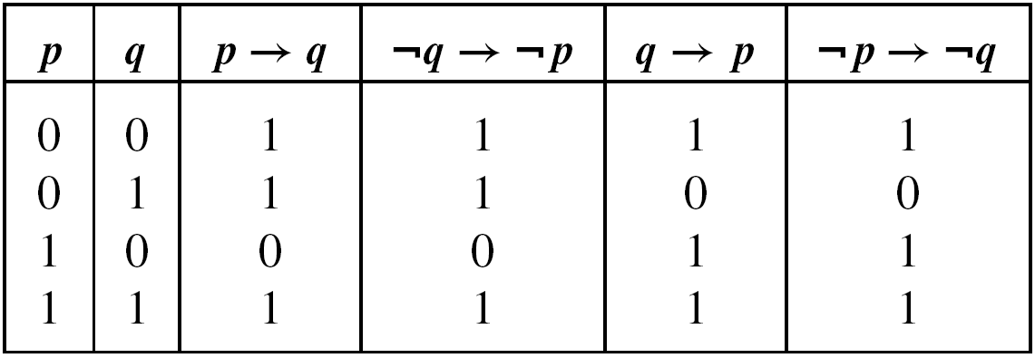
Examples (4/6)
Example 2.15:
  The statement ¬q → ¬p is called the contrapositive of the implication p → q.
  The statement q → p is called the converse of p → q.
  The statement ¬p → ¬q is called the inverse of p → q.
Notes:
Contrapositive:【邏】對換的
Converse: 相反的,顛倒的,逆的
Inverse: 倒轉的;反逆的;反向的

Slide 32
Examples (5/6)
Example 2.15 (cont.):
Let us consider a specific example where p, q represent the statements
p: Jeff is concerned about his cholesterol levels.
q: Jeff walks at least 2 miles 3 times a week.
(The implication: p → q). If Jeff is concerned about his cholesterol levels, then he will walks at least 2 miles 3 times a week.
(The contrapositive: ¬q → ¬p). If Jeff does not walk at least 2 miles 3 times a week, then he is not concerned about his cholesterol levels.

Slide 33
Examples (6/6)
Example 2.15 (cont.):
(The converse: q → p). If Jeff walks at least 2 miles 3 times a week, then he is concerned about his cholesterol levels.
(The inverse: ¬p → ¬q). If Jeff is not concerned about his cholesterol levels, then he will not walks at least 2 miles 3 times a week.

Slide 34
Simplification of Compound Statements (1/2)
Example 2.16: For primitive statements p, q, is there any simpler way to express the compound statement (p ∨ q) ∧ ¬(¬p ∧ q) — that is, can we find a simpler statement that is logically equivalent to the one given?
  (p ∨ q) ∧ ¬(¬p ∧ q) Reasons
  ⇔ (p ∨ q) ∧ (¬¬p ∨ ¬q) DeMorgan’s Law
  ⇔ (p ∨ q) ∧ (p ∨ ¬q) Law of Double Negation
  ⇔ p ∨ (q ∧ ¬q) Distributive Law of ∨ over ∧
  ⇔ p ∨ F₀ Inverse Law
  ⇔ p Identify Law
  Consequently, we see that (p ∨ q) ∧ ¬(¬p ∧ q) ⇔ p

Slide 35
Simplification of Compound Statements (2/2)
Example 2.17: Consider the compound statement ¬[¬[(p ∨ q) ∧ r] ∨ ¬q], where p, q, r are primitive statements.
¬[¬[(p ∨ q) ∧ r] ∨ ¬q] Reasons
⇔ ¬¬[(p ∨ q) ∧ r] ∧ ¬¬q] DeMorgan’s Law
⇔ [(p ∨ q) ∧ r] ∧ q Law of Double Negation
⇔ (p ∨ q) ∧ (r ∧ q) Associative Law of ∧
⇔ (p ∨ q) ∧ (q ∧ r) Commutative Law of ∧
⇔ [(p ∨ q) ∧ q] ∧ r Associative Law of ∧
⇔ q ∧ r Absorption Law (as well as the Commutative Laws for ∧ and ∨)
Notes:
[(p ∨ q) ∧ q] ∧ r → [q ∧ (q ∨ p)] ∧ r → q ∧ r

Slide 36
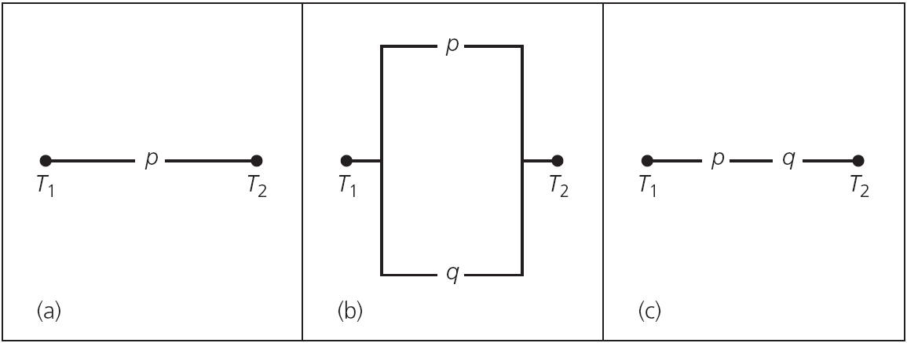
Simplification of Switching Networks (1/4)
A switching network is made up of wires and switches connecting two terminals T₁ and T₂.
  Open (0): No current flows through it.
  Closed (1): Current does flow through it.
Series network, p ∧ q
Parallel network, p ∨ q

Slide 37
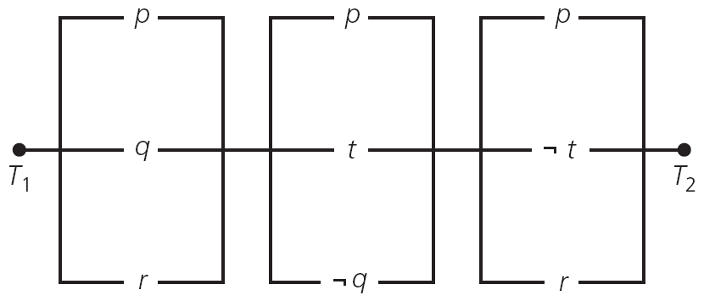
Simplification of Switching Networks (2/4)
Example 2.18:
The switches in a network need not act independently of each other.
This network is represented by the statement (p ∨ q ∨ r) ∧ (p ∨ t ∨ ¬q) ∧ (p ∨ ¬t ∨ r).

Slide 38
Simplification of Switching Networks (3/4)
Example 2.18 (cont.):
(p ∨ q ∨ r) ∧ (p ∨ t ∨ ¬q) ∧ (p ∨ ¬t ∨ r) Reasons
p ∨ [(q ∨ r) ∧ (t ∨ ¬q) ∧ (¬t ∨ r )] Distributive Law of ∨
over ∧
p ∨ [(q ∨ r) ∧ (¬t ∨ r ) ∧ (t ∨ ¬q)] Commutative Law of ∧
⇔ p ∨ [((q ∧ ¬t) ∨ r) ∧ (t ∨ ¬q)] Distributive Law of ∨
over ∧
⇔ p ∨ [((q ∧ ¬t) ∨ r) ∧ (¬¬t ∨ ¬q)] Law of Double Negation
⇔ p ∨ [((q ∧ ¬t) ∨ r) ∧ ¬(¬t ∧ q)] DeMorgan’s Law
⇔ p ∨ [¬(¬t ∧ q) ∧ ((¬t ∧ q) ∨ r)] Commutative Law of ∧
(twice)
⇔ p ∨ [(¬(¬t ∧ q) ∧ (¬t ∧ q)) ∨ Distributive Law (¬(¬t ∧ q) ∧ r)] of ∧ over ∨

Slide 39
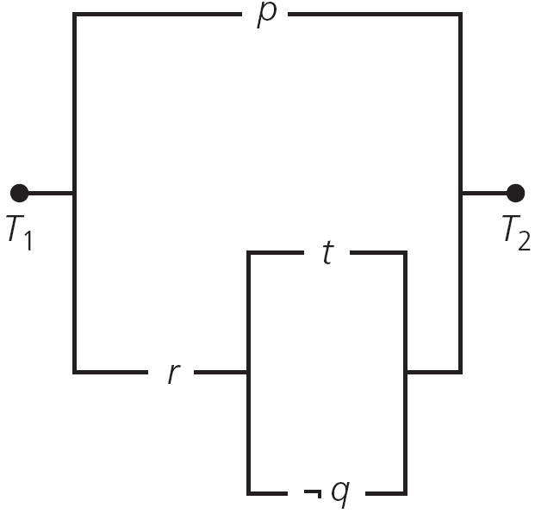
Simplification of Switching Networks (4/4)
Example 2.18 (cont.):
EXERCISES 2.2: 4, 8, 10
⇔ p ∨ [F₀ ∨ (¬(¬t ∧ q) ∧ r)] ¬s ∧ s ⇔ F₀, for any statement s
⇔ p ∨ [(¬(¬t ∧ q)) ∧ r] F₀ is the identity for ∨
⇔ p ∨ [r ∧ ¬(¬t ∧ q)] Commutative Law of ∧
⇔ p ∨ [r ∧ (t ∨ ¬q)] DeMorgan’s Law and the Law of Double Negation

Slide 40
Outline
Basic Connectives and Truth Tables
Logical Equivalence: The Laws of Logic
Logical Implication: Rules of Inference
The Use of Quantifiers
Quantifiers, Definitions, and the Proofs of Theorems

Slide 41
Valid Argument (1/2)
Let us consider the implication
(p₁ ∧ p₂ ∧ p₃ ∧ … ∧ p_{n}) → q.
Here n is a positive integer.
The statements p₁, p₂, p₃, …, p_{n} are called the premises of the argument.
The statement q is the conclusion of the argument.
The argument is called valid if whenever each of the premises p₁, p₂, p₃, …, p_{n} is true, then the conclusion q is likewise true.
Notes:
Premises:假定,假設;前提

Slide 42
Valid Argument (2/2)
If any one of p₁, p₂, p₃, …, p_{n} is false, then the hypothesis (p₁ ∧ p₂ ∧ p₃ ∧ … ∧ p_{n}) is false and the implication (p₁ ∧ p₂ ∧ p₃ ∧ … ∧ p_{n}) → q is automatically true, regardless of the truth value of q.
One way to establish the validity of a given argument is to show that the statement (p₁ ∧ p₂ ∧ p₃ ∧ … ∧ p_{n}) → q is a tautology.
Notes:
Hypothesis:假說;前提

Slide 43
Example (1/3)
Example 2.19: Let p, q, r denote the primitive statements given as
p: Roger studies.
q: Roger plays tennis.
r: Roger passes discrete mathematics.
Now let p₁, p₂, p₃ denote the premises
p₁: If Roger studies, then he will pass discrete mathematics.
p₂: If Roger doesn’t play tennis, then he’ll study.
p₃: Roger failed discrete mathematics.

Slide 44
Example (2/3)
Example 2.19 (cont.):
We want to determine whether the argument
(p₁ ∧ p₂ ∧ p₃) → q
is valid.
To do so, we rewrite p₁, p₂, p₃ as
p₁: p → r p₂: ¬q → p p₃: ¬r
and examine the truth table for the implication
[(p → r) ∧ (¬q → p) ∧ ¬r] → q

Slide 45
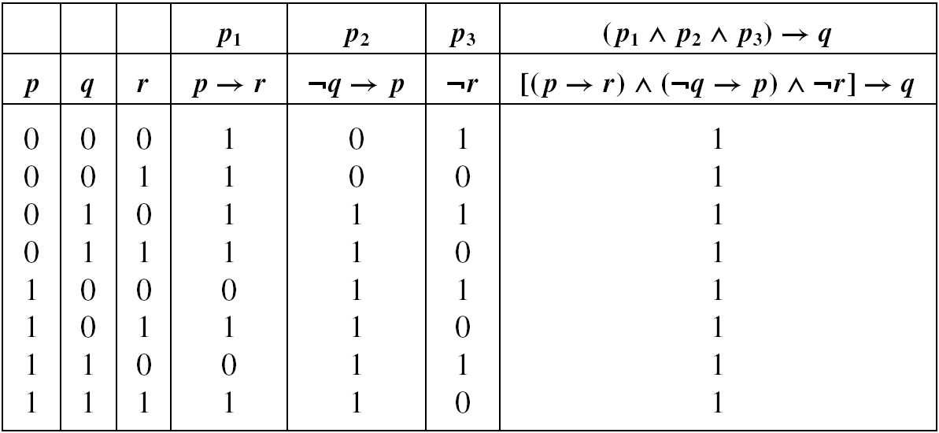
Example (3/3)
Example 2.19 (cont.):
Since the implication is a tautology, we can say that (p₁ ∧ p₂ ∧ p₃) → q is a valid argument.
The truth of the conclusion q is deduced or inferred from the truth of the premises p₁, p₂, and p₃.

Slide 46
Logical Implication
Definition 2.4: If p, q are arbitrary statements such that p → q is a tautology, then we say that p logically implies q and we write p ⇒ q to denote this situation. (We refer to p → q as a logical implication.)

Slide 47
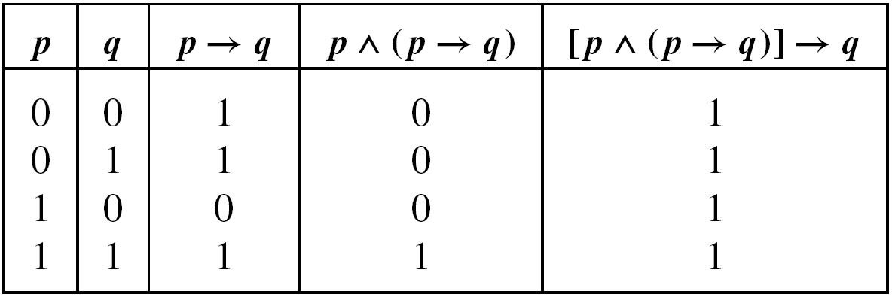
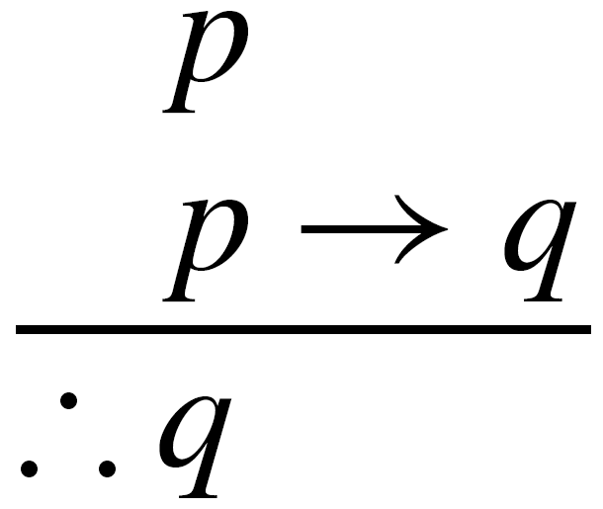
Rule of Inference: Modus Ponens
Example 2.22 (Modus Ponens or Rule of Detachment): In symbolic form this rule is expressed by the logical implication
[p ∧ (p → q)] → q
If (1) p is true, and (2) p → q is true (or p ⇒ q), then the conclusion q must also be true.
Notes:
不需要去看其他的, 因為 p ∧ (p → q) 不成立時, [p ∧ (p → q)] → q 為 true
所以只要看p ∧ (p → q) 為 true 的情況

Slide 48
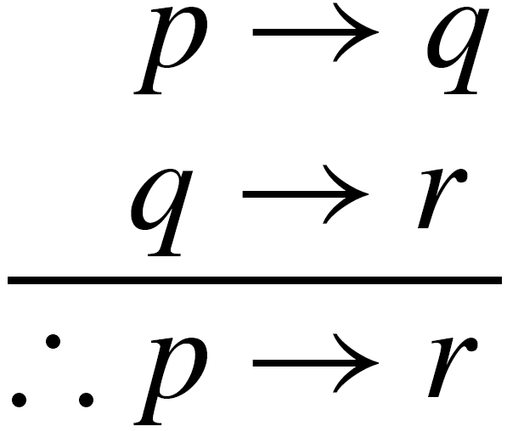
Rule of Inference: Law of the Syllogism (1/2)
Example 2.23 (Law of the Syllogism): This rule is given by the logical implication
[(p → q) ∧ (q → r)] → (p → r),
where p, q, and r are any statements.
In tabular form it is written
Notes:
Syllogism: 三段論;演繹推理

Slide 49
Rule of Inference: Law of the Syllogism (2/2)
Example 2.23 (cont.):
We may use it as follows:
1) If the integer 35244 is divisible by 396,
then the integer 35244 is divisible by 66. p → q
2) If the integer 35244 is divisible by 66,
then the integer 35244 is divisible by 3. q → r
3) Therefore, if the integer 35244 is divisible
by 396, then the integer 35244 is ∴ p → r
divisible by 3.
Notes:
Syllogism: 三段論;演繹推理

Slide 50
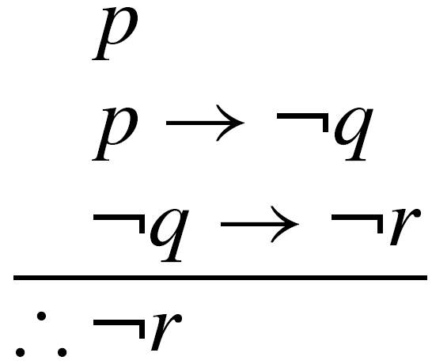
Example (1/3)
Example 2.24: Consider the following argument.
  Rita is baking a cake.
  If Rita is baking a cake, then she is not practicing her flute.
  If Rita is not practicing her flute, then her father will not buy her a car.
  Therefore Rita’s father will not buy her a car.
We may write the argument as

Slide 51
Example (2/3)
Example 2.24 (cont.):
We establish the validity of the argument as follows:
Steps Reasons
1) p → ¬q Premise
2) ¬q → ¬r Premise
3) p → ¬r This follows from steps (1) and (2) and the Law of the Syllogism
4) p Premise
5) ∴¬r This follows from steps (4) and (3) and the Rule of Detachment

Slide 52
Example (3/3)
Example 2.24 (cont.):
A second way to validate the argument as follows:
Steps Reasons
1) p Premise
2) p → ¬q Premise
3) ¬q Steps (1) and (2) and the Rule of the Detachment
4) ¬q → ¬r Premise
5) ∴¬r Steps (3) and (4) and the Rule of
Detachment

Slide 53
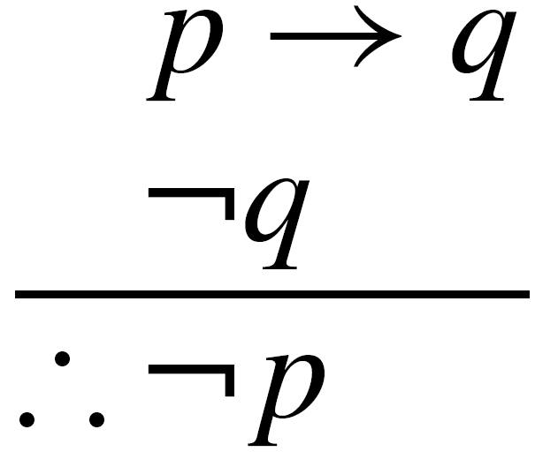
Rule of Inference: Modus Tollens (1/4)
Example 2.25 (Modus Tollens): The rule of inference called Modus Tollens (“method of denying”) is given by
This follows from the logical implication
[(p → q) ∧ ¬q] → ¬p.

Slide 54
Rule of Inference: Modus Tollens (2/4)
Example 2.25 (cont.):
The following exemplifies the use of Modus Tollens in making a valid inference:
1) If Connie is elected president of Phi Delta
sorority, then Helen will pledge that sorority. p → q
2) Helen did not pledge Phi Delta sorority. ¬q
3) Therefore Connie was not elected president
of Phi Delta sorority. ∴¬p
Notes:
Sorority:婦女聯誼會, 女學生聯誼會
Pledge:保證給予;許諾;發誓

Slide 55
Rule of Inference: Modus Tollens (3/4)
Example 2.25 (cont.):
Use Modus Tollens to show that the following argument is valid (for primitive statements p, r, s, t, and u).
p → r
r → s
t ∨ ¬s
¬t ∨ u
¬u
∴¬p

Slide 56
Rule of Inference: Modus Tollens (4/4)
Example 2.25 (cont.):
Steps Reasons
1) p → r, r → s Premises
2) p → s Step (1) and the Law of the Syllogism
3) t ∨ ¬s Premise
4) ¬s ∨ t Step (3) and the Commutative Law of ∨
5) s → t Step (4) and the fact that ¬s ∨ t ⇔ s → t
6) p → t Steps (2) and (5) and the Law of the Syllogism
7) ¬t ∨ u Premise
8) t → u Step (7) and the fact that ¬t ∨ u ⇔ t → u
9) p → u Steps (6) and (8) and the Law of the Syllogism
10) ¬u Premise
11) ∴¬p Steps (9) and (10) and Modus Tollens

Slide 57
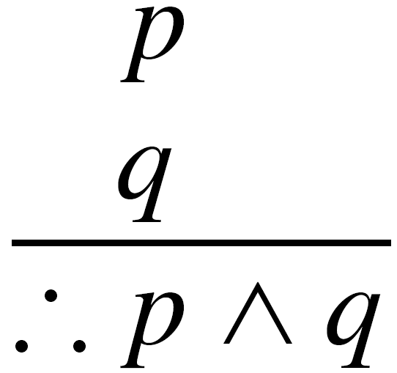
Rule of Inference: Rule of Conjunction
Example 2.26 (Rule of Conjunction): If p, q are true statements, then p ∧ q is a true statement. We call this rule the Rule of Conjunction and write it in tabular form as

Slide 58
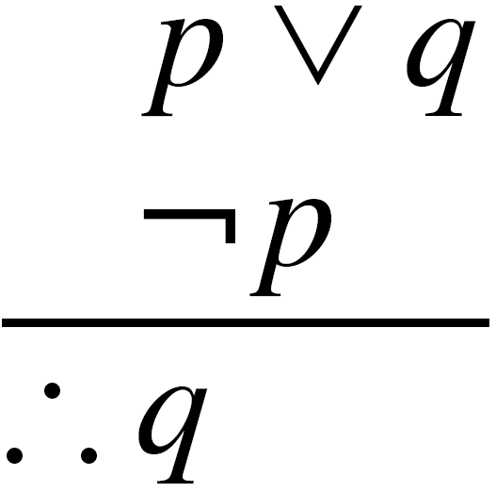
Rule of Inference:
Rule of Disjunctive Syllogism (1/2)
Example 2.27 (Rule of Disjunctive Syllogism): The Rule of Disjunctive Syllogism comes about from the logical implication
[(p ∨ q) ∧ ¬p] → q,
which we can derive from Modus Ponens by
observing that p ∨ q ⇔ ¬p → q.
In tabular form we write

Slide 59
Rule of Inference:
Rule of Disjunctive Syllogism (2/2)
Example 2.27 (cont.):
1) Bart’s wallet is in his back pocket or it is
on his desk.
2) Bart’s wallet is not in his back pocket.
3) Therefore Bart’s wallet in on his desk.

Slide 60

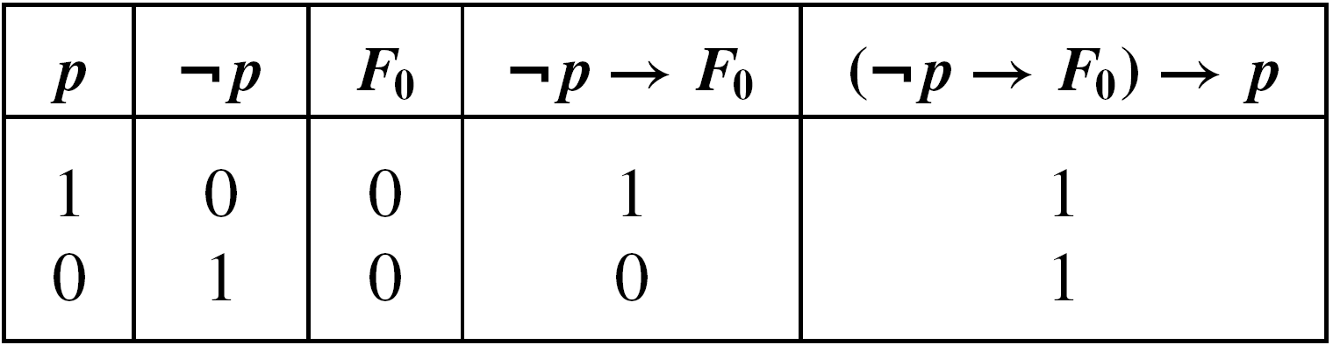
Rule of Inference: Rule of Contradiction (1/2)
Example 2.28 (Rule of Contradiction): Let p denote an arbitrary statement, and F₀ a contradiction. Then (¬p → F₀) → p is a tautology.
If p is a statement and ¬p → F₀ is true, then ¬p must be false because F₀ is false. So then we have p true.

Slide 61
Rule of Inference: Rule of Contradiction (2/2)
Example 2.28 (cont.): The Rule of Contradiction is the basis of a method for establishing the validity of an argument – namely, the method of Proof by Contradiction.
In general, when we want to establish the validity of the argument
We can establish the validity of the logically equivalent argument
Notes:
反證法

Slide 62
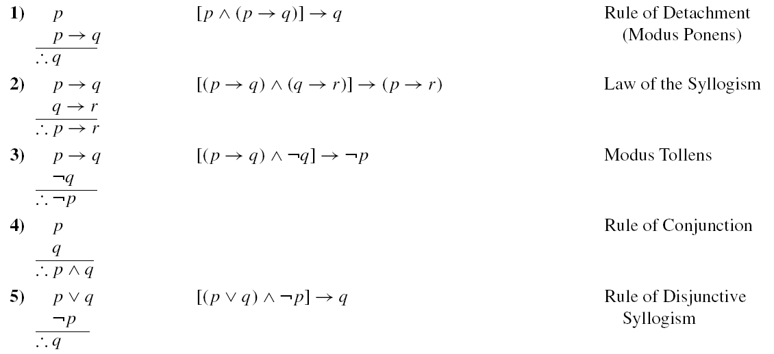
Summary of Inference Rules (1/2)

Slide 63
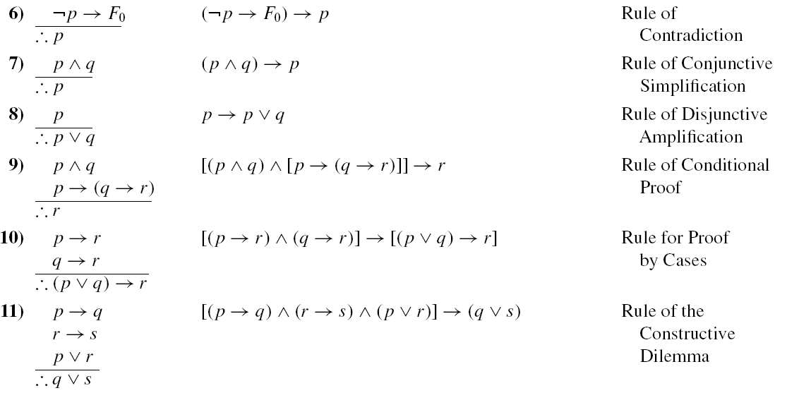
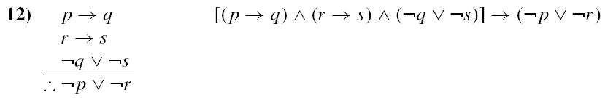

Summary of Inference Rules (2/2)

Slide 64
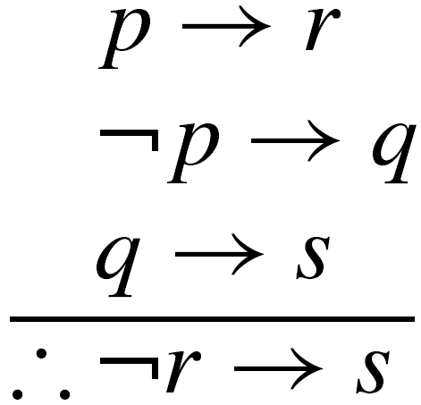
Apply Rules (1/3)
Example 2.29: Our first example demonstrates the validity of the argument
Steps Reasons
1) p → r Premise
2) ¬r → ¬p Step (1) and p → r ⇔ ¬r → ¬p
3) ¬p → q Premise
4) ¬r → q Steps (2) and (3) and the Law of the Syllogism
5) q → s Premise
6) ∴ ¬r → s Steps (4) and (5) and the Law of the Syllogism

Slide 65
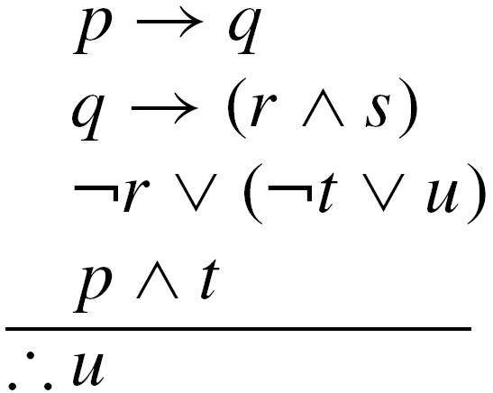
Apply Rules (2/3)
Example 2.30: Establish the validity of the argument
Steps Reasons
1) p → q Premise
2) q → (r ∧ s) Premise
3) p → (r ∧ s) Steps (1) and (2) and the Law of the Syllogism
4) p ∧ t Premise
5) p Step (4) and the Rule of Conjunctive Simplification
6) r ∧ s Step (5) and (3) and the Rule of Detachment
7) r Step (6) and the Rule of Conjunctive Simplification

Slide 66
Apply Rules (3/3)
Example 2.30 (cont.):
8) ¬r ∨ (¬t ∨ u) Premise
9) ¬(r ∧ t) ∨ u Step (8), the Associative Law of ∨, and DeMorgan’s Laws
10) t Step (4) and the Rule of Conjunctive Simplification
11) r ∧ t Steps (7) and (10) and the Rule of Conjunction
12) ∴u Steps (9) and (11) and the Rule of
Disjunctive Syllogism

Slide 67
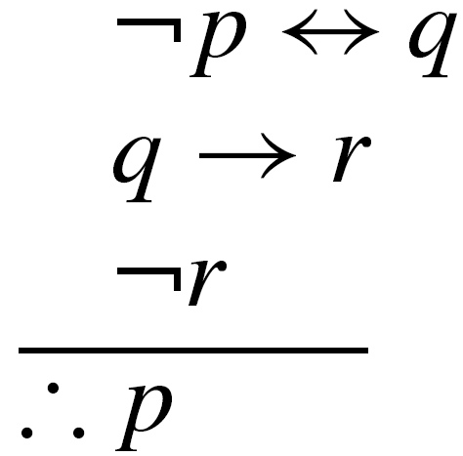
Proof by Contradiction (1/3)
Example 2.32: Consider the argument
To establish the validity for this argument, we assume the negation ¬p of the conclusion p as another premise. The objective now is to use these four premises to derive a contradiction of F₀. Our derivation follows.

Slide 68
Proof by Contradiction (2/3)
Example 2.32 (cont.):
Steps Reasons
1) ¬p ↔ q Premise
2) (¬p → q) ∧ (q → ¬p) Step (1) and (¬p ↔ q) ⇔ [(¬p → q) ∧ (q → ¬p)]
3) ¬p → q Step (2) and the Rule of Conjunctive Simplification
4) q → r Premise
5) ¬p → r Steps (3) and (4) and the Law of
the Syllogism

Slide 69
Proof by Contradiction (3/3)
Example 2.32 (cont.):
6) ¬p Premise (the one assumed)
7) r Steps (5) and (6) and the Rule of
Detachment
8) ¬r Premise
9) r ∧ ¬r (⇔ F₀) Steps (7) and (8) and the Rule
of Conjunction
10) ∴p Steps (6) and (9) and the method
of Proof by Contradiction

Slide 70
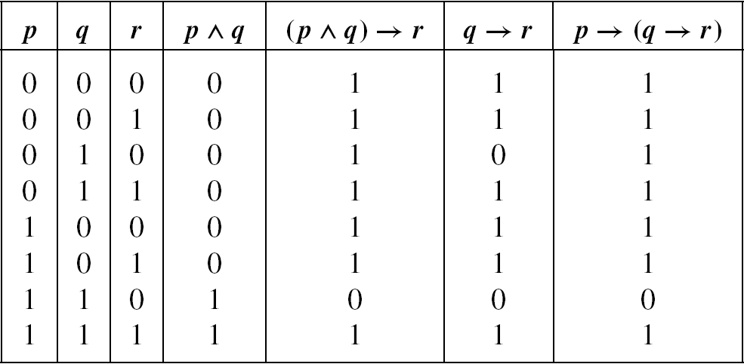
Principle
[p → (q → r)] ⇔ [(p ∧ q) → r]

Slide 71
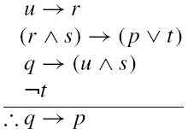
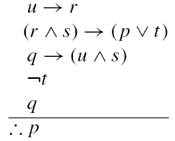
Example (1/3)
Example 2.33: In order to establish the validity of the argument
We consider the corresponding argument

Slide 72
Example (2/3)
Example 2.33 (cont.):
Steps Reasons
1) q Premise
2) q → (u ∧ s) Premise
3) u ∧ s Steps (1) and (2) and the Rule of
Detachment
4) u Step (3) and the Rule of Conjunctive Simplification
5) u → r Premise
6) r Steps (4) and (5) and the Rule of
Detachment
7) s Step (3) and the Rule of Conjunctive Simplification

Slide 73
Example (3/3)
Example 2.33 (cont.):
8) r ∧ s Steps (6) and (7) and the Rule of
Conjunction
9) (r ∧ s) → (p ∨ t) Premise
10) p ∨ t Steps (8) and (9) and the Rule of
Detachment
11) ¬t Premise
12) ∴p Steps (10) and (11) and the Rule of Disjunctive Syllogism

Slide 74
Counterexample of the Argument (1/3)
Given an argument p₁ ∧ p₂ ∧ p₃ ∧ … p_{n} → q
we say that the argument is invalid if it is possible for each of the premises p₁, p₂, p₃, …, p_{n} to be true (with truth value 1), while the conclusion q is false (with truth value 0).
Notes:
要證明一個 argument 是對的, 必須證明所有 case
要證明一個 argument 是錯的, 只要找出一組 assignment 反證即可

Slide 75
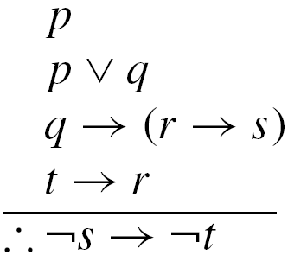
Counterexample of the Argument (2/3)
Example 2.34: Consider the primitive statements p, q, r, s, and t and the argument
Show that this is an invalid argument.

Slide 76
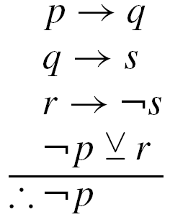
Counterexample of the Argument (3/3)
Example 2.35: What can we say about the validity or invalidity of the following argument? Here p, q, r, and s denote primitive statements.
EXERCISES 2.3: 4, 6, 8

Slide 77
Outline
Basic Connectives and Truth Tables
Logical Equivalence: The Laws of Logic
Logical Implication: Rules of Inference
The Use of Quantifiers
Quantifiers, Definitions, and the Proofs of Theorems

Slide 78
Open Statement
Definition 2.5: A declarative sentence is an open statement if
  it contains one or more variables, and
  it is not a statement, but
  it becomes a statement when the variables in it are replaced by certain allowable choices.
These allowable choices constitute what is called the universe or universe of discourse for the open statement.

Slide 79
Notation of Open Statement (1/2)
The open statement “The number x + 2 is an even integer” is denoted by p(x) [or q(x), etc.].
Then ¬p(x) may be read “The number x + 2 is not an even integer.”
We use q(x, y) to represent an open statement that contains two variables.

Slide 80
Notation of Open Statement (2/2)
Two types of quantifiers
  The existential quantifier ∃
  The universal quantifier ∀
Example: r(x): “2x is an even integer” with the universe of all integers.
∀x r(x) and ∃x r(x) both are true statements.
The variable x in each of open statements p(x) is called a free variable (of the open statement).
For ∃x p(x, y), ∀x p(x, y)
  x is a bounded variable
  y is a free variable
Notes:
Quantifier:【語】數量詞;【邏】量詞

Slide 81
Example (1/3)
Example 2.36: Here the universe comprises all real numbers.
p(x): x ≥ 0 r(x): x² – 3x – 4 = 0
q(x): x² ≥ 0 s(x): x² – 3 > 0
∃x [p(x) ∧ r(x)]
∀x [p(x) → q(x)]
∀x [q(x) → s(x)]
∀x [r(x) ∨ s(x)]
∀x [r(x) → p(x)]
TRUE
TRUE
FALSE
FALSE
FALSE
Notes:
p(4) and r(4)
All nonnegative real numbers have nonnegative squares.
Every real number a between 正負根號3 will make q(a) true and s(a) false.
1, ½, –3/2, and 0 produce counterexamples.
The choice of –1 provides the unique counterexample we need to show that this (quantified) statement is false.

Slide 82
Example (2/3)
Example 2.39: In the following program segment, n is an integer variable and the variable A is an array A[1], A[2], …, A[20] of 20 integer values.
for n := 1 to 20 do
A[n] := n * n – n
Represent the following statements about the array A in quantified form, where the universe consists of all integers from 1 to 20, inclusive.
Notes:
此處 universe 指 n, 非 A[n]

Slide 83
Example (3/3)
Example 2.39 (cont.):
1) Every entry in the array is nonnegative:
∀n (A[n] ≥ 0).
2) There exist two consecutive entries in A where
the larger entry is twice the smaller:
∃n (A[n + 1] = 2A[n]).
3) The entries in the array are sorted in (strictly)
ascending order:
∀n [(1 ≤ n ≤ 19) → (A[n] < A[n+1])].
4) The entries in the array are distinct:
∀m ∀n [(m ≠ n) → (A[m] ≠ A[n])], or
∀m, n [(m < n) → (A[m] ≠ A[n])].

Slide 84
Definitions (1/2)
Definition 2.6: Let p(x), q(x) be open statements defined for a given universe. The open statements p(x) and q(x) are called (logically) equivalent, and we write ∀x [p(x) ⇔ q(x)] when the biconditional p(a) ↔ q(a) is true for each replacement a from the universe (that is, p(a) ⇔ q(a) for each a in the universe). If the implication p(a) → q(a) is true for each a in the universe (that is, p(a) ⇒ q(a) for each a in the universe), then we write ∀x [p(x) ⇒ q(x)] and say that p(x) logically implies q(x).

Slide 85
Definitions (2/2)
Definition 2.7: For open statements p(x), q(x) — defined for a prescribed universe — and the universally quantified statement ∀x [p(x) → q(x)] we define:
  The contrapositive of ∀x [p(x) → q(x)] to be ∀x [¬q(x) → ¬p(x)].
  The converse of ∀x [p(x) → q(x)] to be
  ∀x [q(x) → p(x)].
  The inverse of ∀x [p(x) → q(x)] to be
  ∀x [¬p(x) → ¬q(x)].
Notes:
Prescribed: 規定的

Slide 86
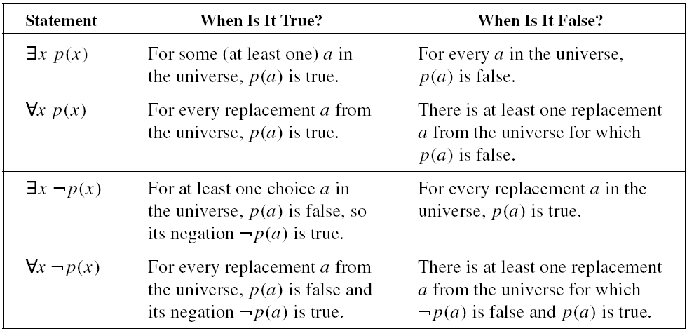
Summarization of Quantifiers

Slide 87


Example
Example 2.42: Here the universe consists of all the integers, and the open statements r(x), s(x) are given by
r(x): 2x + 1 = 5 s(x): x² = 9.
is true.
is false.
(is not logically equivalent to)
(does not logically imply)

Slide 88
Logical Equivalences and Logical Implications for Quantified Statements
For a prescribed universe and any statements p(x), q(x) in the variable x:
∃x [p(x) ∧ q(x)] ⇒ [∃x p(x) ∧ ∃x q(x)]
∃x [p(x) ∨ q(x)] ⇔ [∃x p(x) ∨ ∃x q(x)]
∀x [p(x) ∧ q(x)] ⇔ [∀x p(x) ∧ ∀x q(x)]
[∀x p(x) ∨ ∀x q(x)] ⇒ ∀x[ p(x) ∨ q(x)]
How about the other direction?
Notes:
右邊 只要有任一成立即可 左邊 p(x) 全部成立 or q(x) 全部成立

Slide 89
Rules for Negating Statements
Rules for Negating Statements with One Quantifier
¬[∀x p(x)] ⇔ ∃x ¬p(x)
¬[∃x p(x)] ⇔ ∀x ¬p(x)
¬[∀x ¬p(x)] ⇔ ∃x ¬¬p(x) ⇔ ∃x p(x)
¬[∃x ¬p(x)] ⇔ ∀x ¬¬p(x) ⇔ ∀x p(x)

Slide 90


Order of Quantifiers
Example 2.48: We restrict ourselves here to the universe of all integers and let p(x, y) denote the open statement “x + y = 17.”
The statement is true.
The statement is false.
Notes:
For any x, y = 17 – x
If the statement was true, every integer (x) would equal 17 – y. (All integers are equal.)

Slide 91

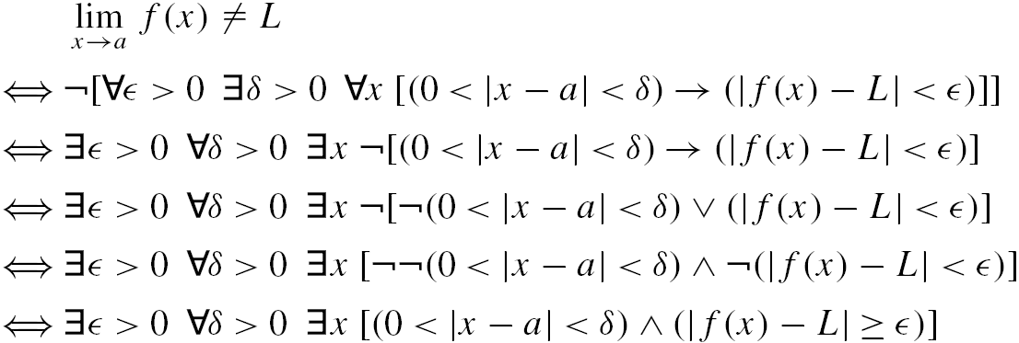
Negate the Definition of Limit
Example 2.50: Negate the definition of limit.
EXERCISE 2.4: 18

Slide 92
Outline
Basic Connectives and Truth Tables
Logical Equivalence: The Laws of Logic
Logical Implication: Rules of Inference
The Use of Quantifiers
Quantifiers, Definitions, and the Proofs of Theorems
Notes:
In this section we shall combine some of the idea we have already studied in the prior two section.

Slide 93
The Rule of Universal Specification
If an open statements becomes true for all replacements by the members in a given universe, then that open statement is true for each specific individual member in that universe. (A bit more symbolically — if p(x) is an open statement for a given universe, and if ∀x p(x) is true, then p(a) is true for each a in the universe.)

Slide 94
Example (1/9)
Example 2.53: a) For the universe of all people, consider the open statements
m(x): x is a mathematics professor
c(x) : x has studied calculus.
Now consider the following argument.
  All mathematics professors have studied calculus.
  Leona is a mathematics professor.
  Therefore Leona has studied calculus.

Slide 95
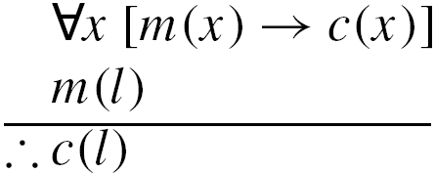
Example (2/9)
Example 2.53 (cont.):
Let l represent this particular woman (in our universe) named Leona.
Steps Reasons
1. ∀x [m(x) → c(x)] Premise
2. m(l) Premise
3. m(l) → c(l) Step (1) and the Rule of Universal Specification
4. ∴ c(l) Steps (2) and (3) and the Rule of Detachment

Slide 96
Example (3/9)
Example 2.53 (cont.): b) For an example of a more mathematical nature let us consider the universe of all triangles in the plane in conjunction with the open statements
p(t): t has two sides of equal length.
q(t): t is an isosceles triangle.
r(t): t has two angles of equal measure.
Let triangle XYZ with no two angles of equal measure be designed by c.
Notes:
Isosceles:【數】二等邊的

Slide 97
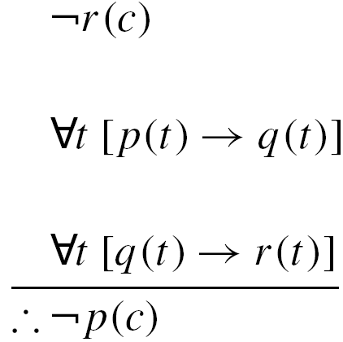
Example (4/9)
Example 2.53 (cont.):
In triangle XYZ there is no pair of
angles of equal measure.
If a triangles has two sides of equal
length, then it is isosceles.
If a triangle is isosceles, then is has
two angles of equal measure.
Therefore triangle XYZ has no two
sides of equal length.
is a valid one — as evidenced by the following.
Notes:
Isosceles: 【數】二等邊的

Slide 98
Example (5/9)
Example 2.53 (cont.):
Steps Reasons
1. ∀t [p(t) → q(t)] Premise
2. p(c) → q(c) Step (1) and the Rule of Universal
Specification
3. ∀t [q(t) → r(t)] Premise
4. q(c) → r(c) Step (3) and the Rule of Universal
Specification
5. p(c) → r(c) Steps (2) and (4) and the Law of
the Syllogism
6. ¬r(c) Premise
7. ∴ ¬p(c) Steps (5) and (6) and Modus Tollens

Slide 99
Example (6/9)
Example 2.53 (cont.): c) Here we’ll consider the universe to be made up of the entire student body at a particular college. One specific student, Mary Gusberti, will be designated by m.
For this universe and the open statements.
j(x): x is a junior s(x): x is a senior
p(x): x is enrolled in a physical education class.

Slide 100
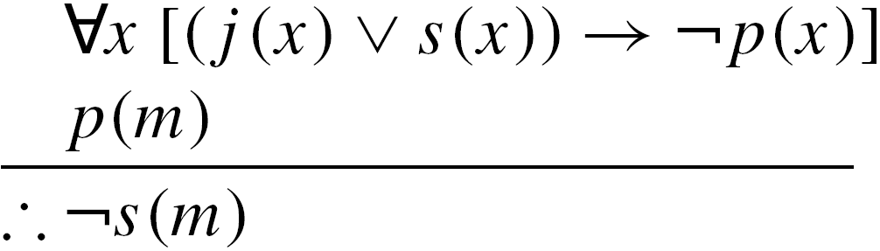
Example (7/9)
Example 2.53 (cont.):
We consider the argument :
No junior or senior is enrolled in a physical education class.
Mary Gusberti is enrolled in a physical education class.
Therefore Mary Gusberti is not a senior.

Slide 101
Example (8/9)
Example 2.53 (cont.):
Steps Reasons
1. ∀x [(j(x) ∨ s(x)) → ¬p(x)] Premise
2. p(m) Premise
3. (j(m) ∨ s(m)) → ¬p(m) Step(1) and the Rule of
Universal Specification
4. p(m) → ¬(j(m) ∨ s(m)) Step(3), (q → t) ⇔ (¬t → ¬q), and the Law of Double Negation
5. p(m) → (¬j(m) ∧ ¬s(m)) Step (4) and DeMorgan’s
Law

Slide 102
Example (9/9)
Example 2.53 (cont.):
6. ¬j(m) ∧ ¬s(m) Steps (2) and (5) and the Rule of Detachment
(or Modus Ponens)
7. ∴ ¬s(m) Step (6) and the Rule of Conjunctive Simplification

Slide 103
Some Possible Errors (1/3)
Within the universe of all polygons in the plane, let c denote one specific polygon – the quadrilateral EFGH, where the measure of angle E is 91°. For the open statements
p(x): x is a square q(x): x has four sides,
the following argument is invalid.
All squares have four sides.
Quadrilateral EFGH has four sides.
Therefore quadrilateral EFGH is a square.

Slide 104
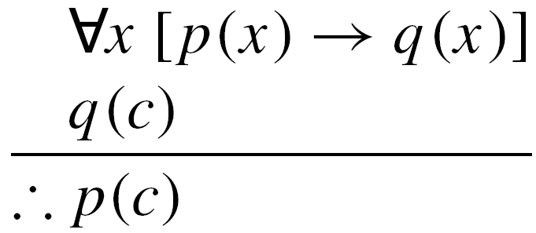
Some Possible Errors (2/3)
Within the universe of all polygons in the plane, let c denote one specific polygon – the quadrilateral EFGH, where the measure of angle E is 91°. For the open statements
p(x): x is a square q(x): x has four sides,
the following argument is invalid.
All squares have four sides.
Quadrilateral EFGH has four sides.
Therefore quadrilateral EFGH is a square.
Notes:
p(x): x 是豬
q(x): x 吃很多

Slide 105
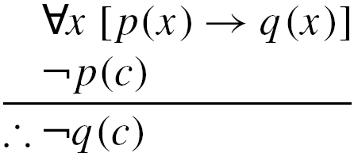
Some Possible Errors (3/3)
p(x): x is a square q(x): x has four sides,
The following argument is invalid.
All squares have four sides.
Quadrilateral EFGH is not a square.
Therefore quadrilateral EFGH does not have four sides.

Slide 106
The Rule of Universal Generalization
If an open statement p(x) is proved to be true when x is replaced by any arbitrarily chosen element c from our universe, then the universally quantified statement ∀x p(x) is true. Furthermore, the rule extends beyond a single variable. So if, for example, we have an open statement q(x, y) that is proved to be true when x and y are replaced by arbitrarily chosen elements from the same universe, or their own respective universes, then the universally quantified statement ∀x∀y q(x, y)[or, ∀x, y q(x, y)] is true. Similar results hold for the cases of three or more variables.

Slide 107
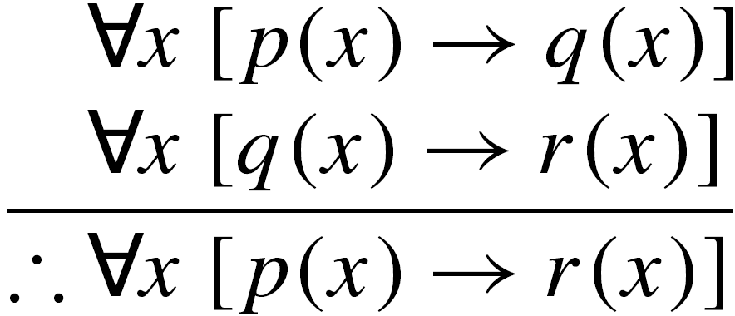
Example (1/5)
Example 2.54: Let p(x), q(x), and r(x) be open statements that are defined for a given universe. We show that the argument
is valid by considering the following.

Slide 108
Example (2/5)
Example 2.54 (cont.):
Steps Reasons
1) ∀x [p(x) → q(x)] Premise
2) p(c) → q(c) Step (1) and the Rule of Universal Specification
3) ∀x [q(x) → r(x)] Premise
4) q(c) → r(c) Step (3) and the Rule of Universal Specification
5) p(c) → r(c) Steps (2) and (4) and the Law of the Syllogism
6) ∴∀x [p(x) → r(x)] Step (5) and the Rule of Universal Generalization
Notes:
The element c introduced in steps 2 and 4 is the same specific but arbitrarily chosen element from the universe.

Slide 109
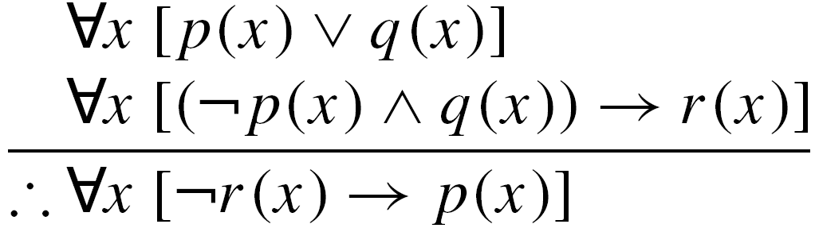
Example (3/5)
Example 2.56: The steps and reasons needed to establish the validity of the argument
are given as follows.
Steps Reasons
1) ∀x [p(x) ∨ q(x)] Premise
2) p(c) ∨ q(c) Step (1) and the Rule of
Universal Specification

Slide 110
Example (4/5)
Example 2.56 (cont.):
3) ∀x [(¬p(x) ∧ q(x)) → r(x)] Premise
4) [¬p(c) ∧ q(c)] → r(c) Step (3) and the Rule of Universal Specification
5) ¬r(c) → ¬[¬p(c) ∧ q(c)] Step (4) and
s → t ⇔ ¬t → ¬ s
6) ¬r(c) → [p(c) ∨ ¬q(c)] Step (5), DeMorgan’s Law, and the Law of Double Negation
7) ¬r(c) Premise (assumed)
8) p(c) ∨ ¬q(c) Step (7) and (6) and Modus Ponens

Slide 111
Example (5/5)
Example 2.56 (cont.):
9) [p(c) ∨ q(c)] ∧ [p(c) ∨ ¬q(c)]Steps (2) and (8) and the Rule of Conjunction
10) p(c) ∨ [q(c) ∧ ¬q(c)] Step (9) and the Distributive Law of ∨ over ∧
11) p(c) Step (10),
q(c) ∧ ¬q(c) ⇔ F₀, and
p(c) ∨ F₀ ⇔ p(c)
12) ∴∀x [¬r(x) → p(x)] Steps (7) and (11) and the Rule of Universal Generalization

Slide 112
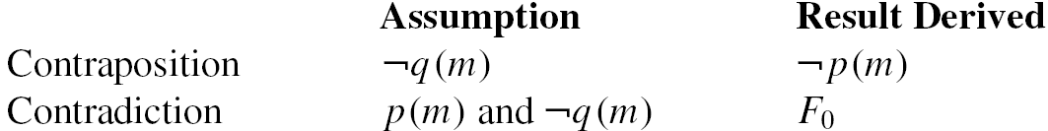
Read by Yourself
Definition 2.8
Theorem 2.2
Theorem 2.3
Theorem 2.4
Theorem 2.5
Suppose we want to prove ∀m [p(m) → q(m)], we could prove it by the contrapositive method or by contradiction.

Slide 113
Homework Assignment #2
EXERCISES 2.1
4, 6
EXERCISES 2.2
4, 8, 10
EXERCISES 2.3
4, 6, 8
EXERCISE 2.4
18
EXERCISE 2.5
10

